Slide 1


1

Slide 2

Predicting Under Five Mortality in HAITI
(A Machine Learning Approach)

Slide 3
Agenda
Introduction
Systems Analysis of Problem
Relevant Analytics
Alternative Solutions
Recommendations
Appendix

Slide 4

Introduction
I am Fred Junior NOEL, I am a Statistician-Economist and Data Analyst.
I am a passionate of Population and Public Health studies,
especially those on the Haitian population.
The problem concerns the Infant Mortality (Under Five Mortality) in HAITI.
I was shocked to see a newborn die less than 48 hours after birth due to an avoidable risk: respiratory failure
It is a phenomenon of actuality in the country which testifies the conditions of precarity of the children

Slide 5
Systems Analysis
This problem affects the whole population, especially the responsible parents, the state institutions and even the international institutions working in the field of childhood.
Our research aims to understand this situation through the data (EMMUS-VI, 2016-2017), to analyze them, to find relationships of dependence. Then we will build several models to predict this phenomenon. Finally, through all these steps, we will propose and analyze concrete solutions to then give recommendations.
The Ministry of Public Health and Population, the Haitian Children's Institute, UNICEF, USAID, and Haitian parents will use these models to prevent child mortality.
The expected result in the short and medium term is a significant decrease in the number of deaths among live births under the age of 5. (49 per thousand in 2019)

Slide 6
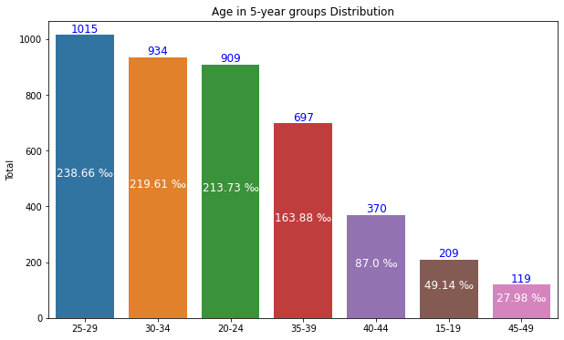
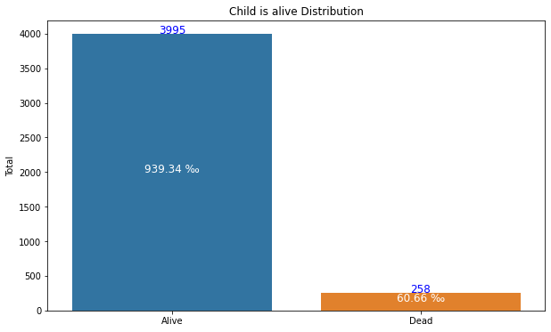
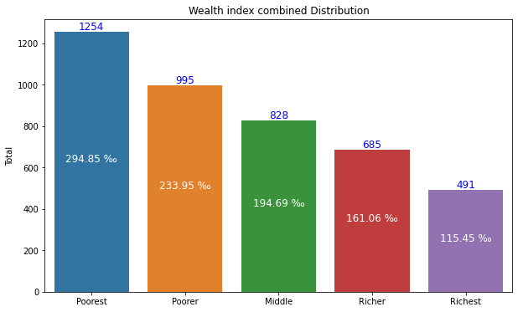
Relevant Analytics
- In the 5 years prior to the survey, the infant mortality rate was 67 deaths per 1000 live births
- During this same period, the largest births were in the 25-29 age group.
- An Wealth index combined has been calculated using a PCA. 285 births out of 1000 lived in the poorest category.

Slide 7
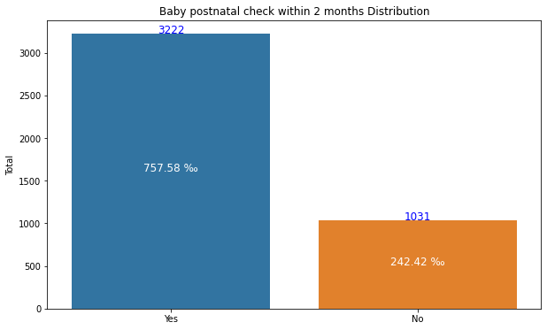
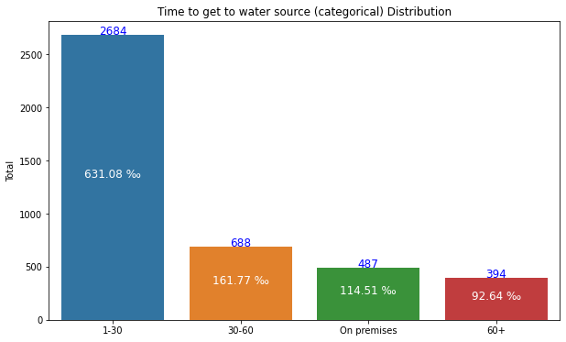
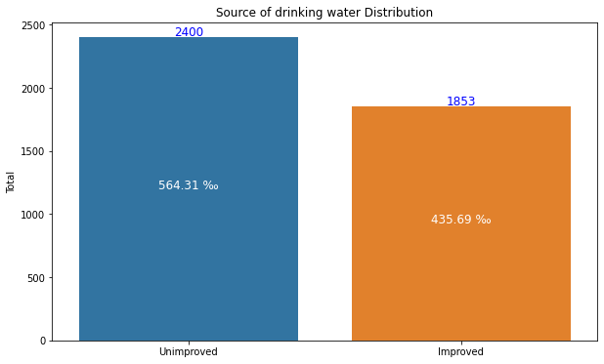
Out of 1000 live births:
More than 564 don’t have access to an improved water source. And only 115 have access to water on premises.
Approximately 240 have no post natal check within 2 months.

Slide 8
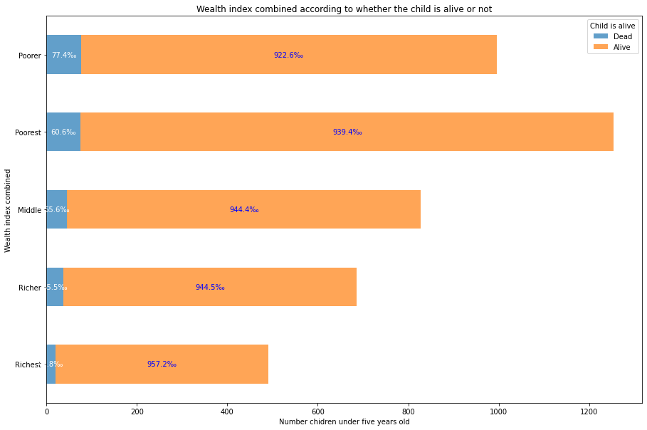
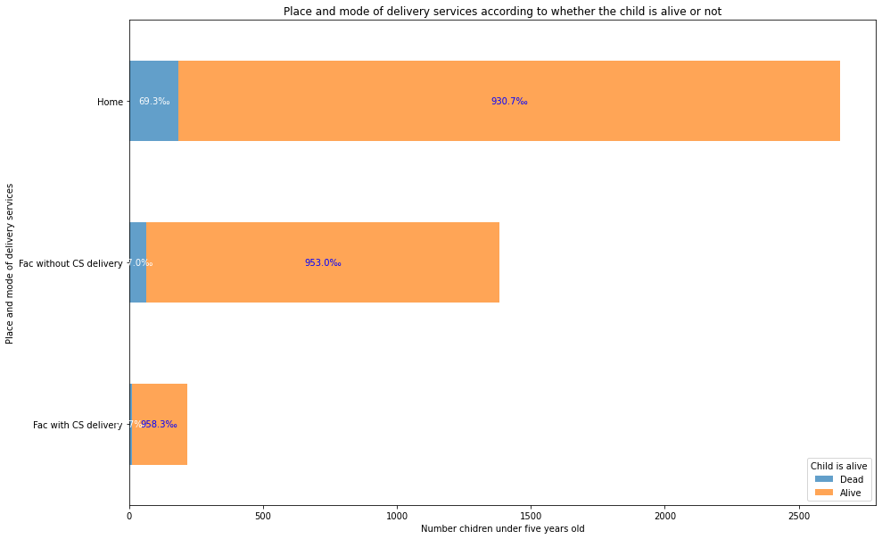
Dependency relationship with the variable "Child is Alive or Dead
Out of 1000 live births:
78 died in the Poorer Wealth index combined, more than 60 in the Poorest.
70 knowing that the mother gave birth at home.

Slide 9
Prediction Models:
For the prediction, we used 3 algorithms of Supervised Learning: Logistic Regression, Random Forest and KNN
In the process of verification...

Slide 10
Recommendations
In the immediate future, we recommend that the MSPP, through the Direction Nationale de l'Eau Potable et de l'Assainissement, rehabilitate and increase water distribution facilities. The difficulties of finding water and of good quality remain a big problem.

Slide 11

Appendix
For more details on my work, please visit my GitHub account:
https://github.com/bolossi509/Capstone-Project.git

